Slide 1

The Principles of Diffusion Models: From Origins to Advances
Chapter 2 Jason Pacheco

Slide 2
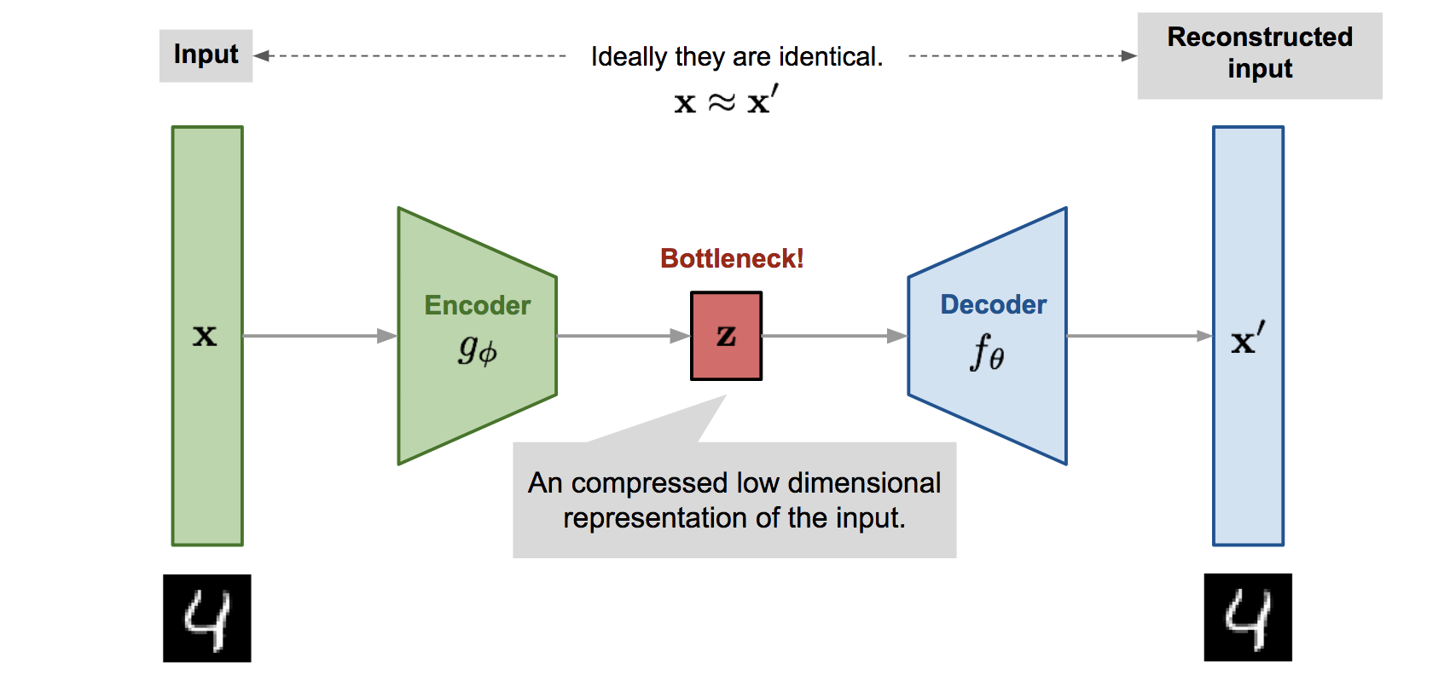
Autoencoder

Slide 3
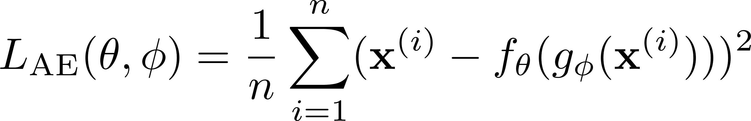
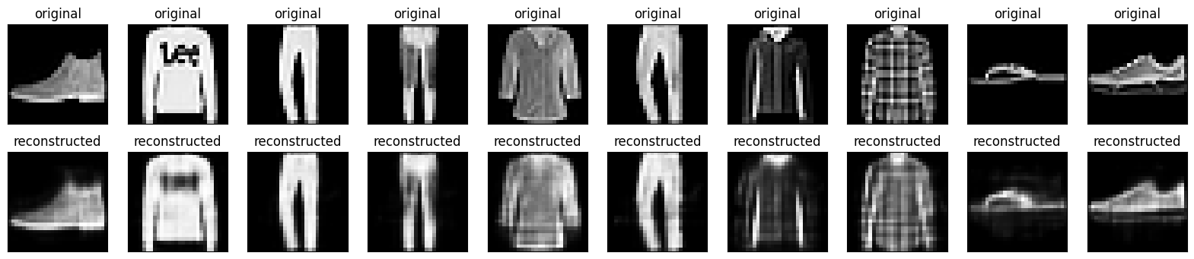
Learning
Mean squared error (MSE) reconstruction loss:

Slide 4
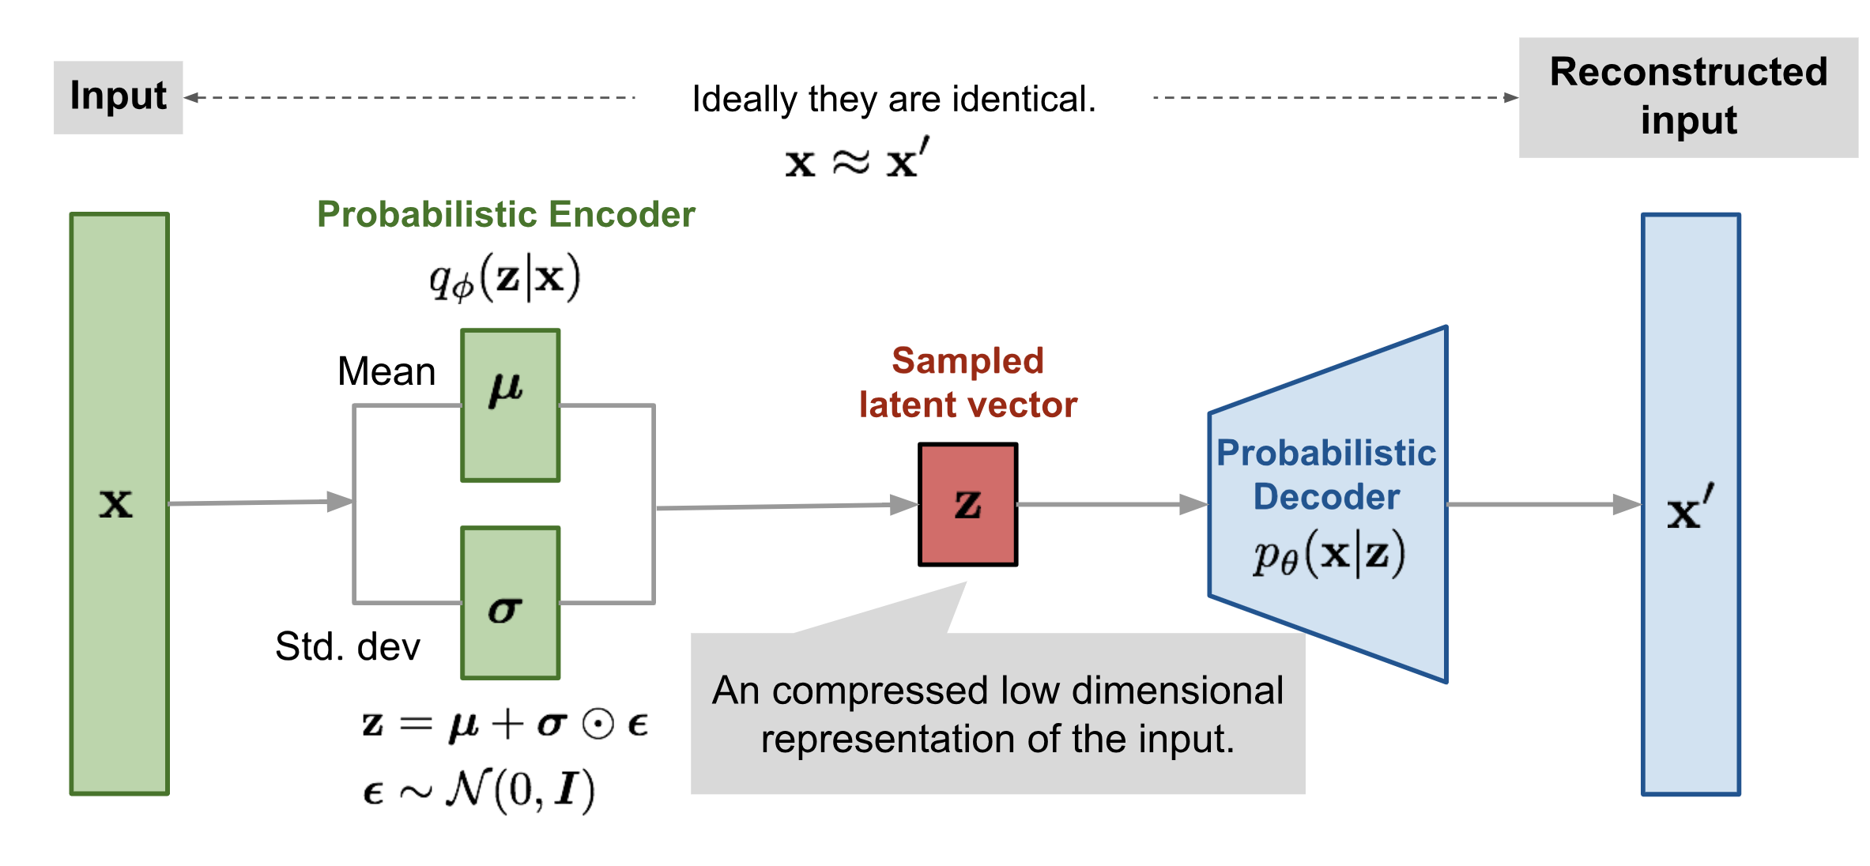
Variational Autoencoder

Slide 5
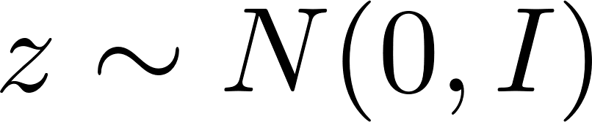
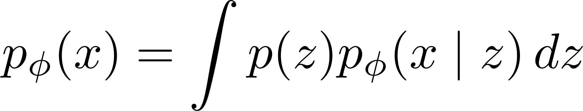
Construction of the Decoder (Generator)
Model assumes each output x is generated from a latent encoding z
Latent representation typically a standard Gaussian prior:
VAE defines a latent-variable model via the marginal likelihood:
We would ideally like to maximize this marginal likelihood, but we can’t because it lacks a closed-form in general
Q: If z were 2D couldn’t we just discretize?

Slide 6
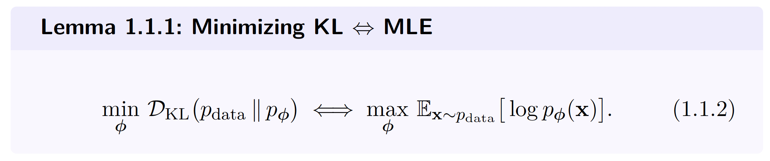

Slide 7
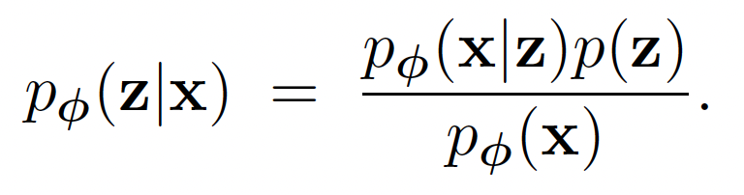
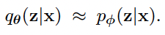
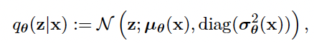
Construction of the Encoder (Inference Network)
Bayes’ rule gives us the posterior over latents:
Variational approximation of posterior:
Typically, a Gaussian distribution:
Can’t compute this…

Slide 8
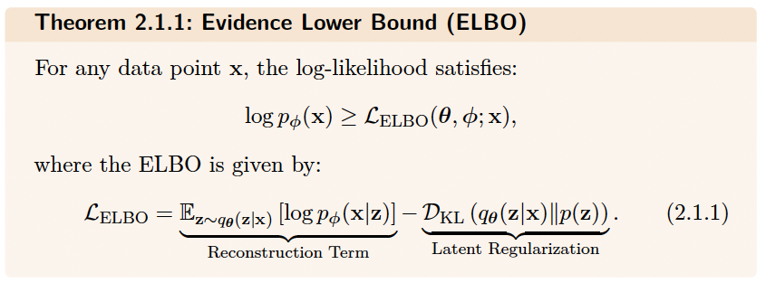

Training the Evidence Lower Bound (ELBO)
Encourages accurate recovery of x from its latent code z.
Encourages the encoder distribution q_{θ}(z|x) to stay close to a simple Gaussian prior p_{prior}(z).

Slide 9
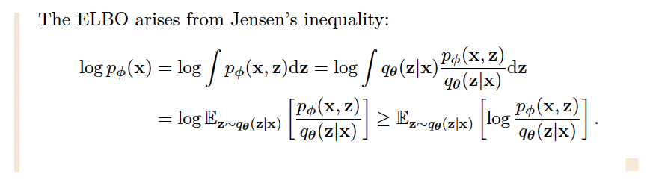
Proof of ELBO

Slide 10
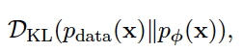
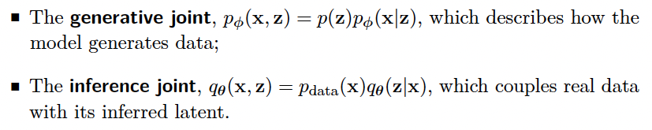
Information-Theoretic View
Recall that MLE corresponds to KL-divergence minimization:
Measures how well model matches data generating distribution
Consider two joint distributions:
Comparing these yields the inequality:

Slide 11
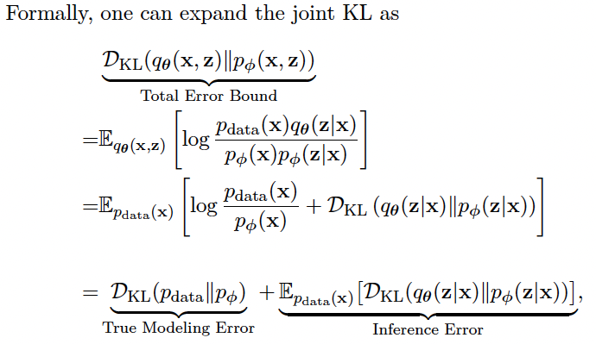
Information-Theoretic View

Slide 12
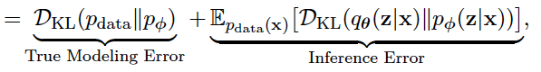
Information-Theoretic View
Recall,
So,
Nonnegative. This is our ELBO gap.
Inference error is gap between log-likelihood and ELBO.
Maximizing ELBO is the same as minimizing inference error
Ensures training minimizes meaningful part of bound (???)

Slide 13
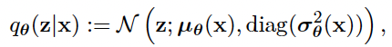
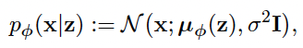
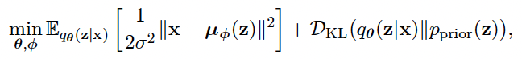
Gaussian VAE
Things simplify when we assume Gaussian distributions,
ELBO reduces to,
This is just a regularized version of the standard autoencoder L2 reconstruction loss.

Slide 14
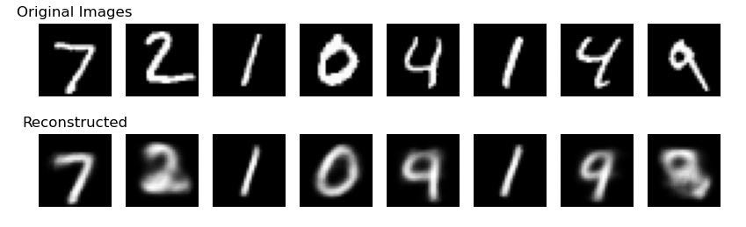
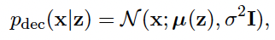
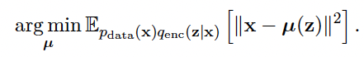
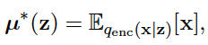
Drawbacks of Standard VAE: Blurry Generation
Consider a fixed encoder q_{enc}(z|x) and a Gaussian decoder,
With an arbitrary encoder, optimizing ELBO is (up to additive constant):
Standard least-squares given by conditional mean:

Slide 15
Drawbacks of Standard VAE: Blurry Generation
Suppose two distinct inputs x != x’ mapped to overlapping regions in latent space
Then decoder averages over multiple outputs
Leads to blurry non-distinct outputs
Fundamental characteristic of VAE-generated samples

Slide 16
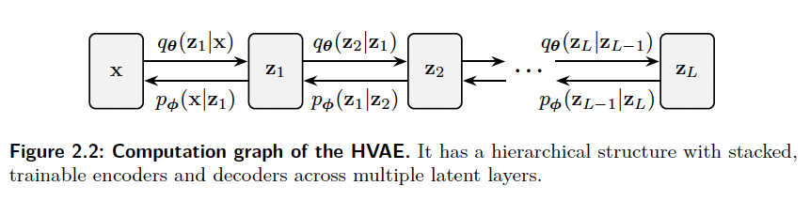
Hierarchical VAEs
Allows the model to capture data features at multiple levels of abstraction, significantly boosting expressive power and mirroring the compositional nature of real-world data.

Slide 17
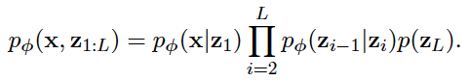
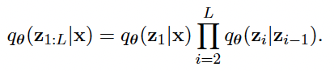
Hierarchical VAEs
Instead of a single latent code (z) introduce an autoregressive sequence of latent codes,
Structured latent variable encoder:

Slide 18
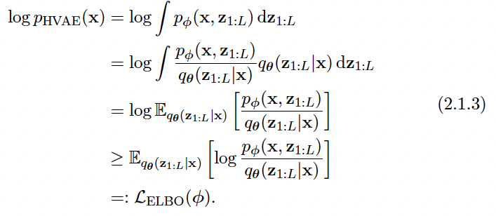
HVAEs ELBO
Can substitute factorized forms on previous slide for expanded ELBO.

Slide 19
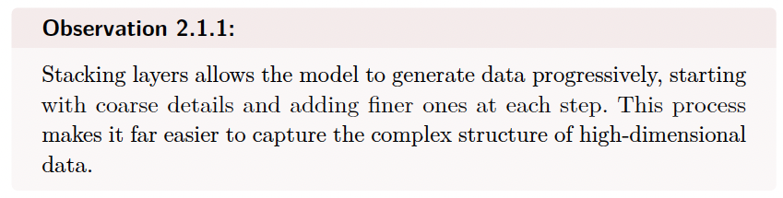
Hierarchical VAEs

Slide 20
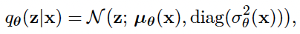
Can’t we just use deeper encoder / decoder in VAE?
Deeper network just corresponds to more complex \mu and \sigma
Doesn’t expand family of approximating distributions
Still unimodal
Also, posterior collapse…

Slide 21
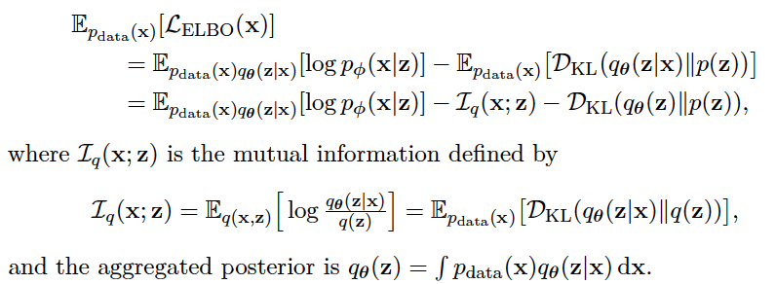
Posterior Collapse
Decoder may be able to model data without using latent encoding z
Maximizer of ELBO sets,
This is the “ignore z” solution

Slide 22
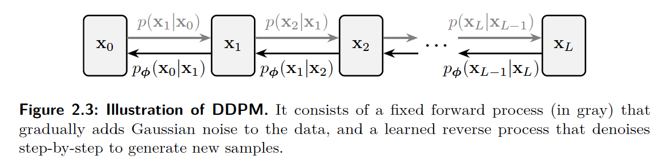
Denoising Diffusion Probabilistic Model (DDPM)
Forward Pass (Fixed Encoder): Gradually corrupts data by injecting Gaussian noise over multiple steps via transition kernel p(x_{i}|x_{i-1})
Reverse Denoising Process (Learnable Decoder): NN learns to reverse noise corruption through a parameterized distribution p(x_{i-1}|x_{i}).

Slide 23
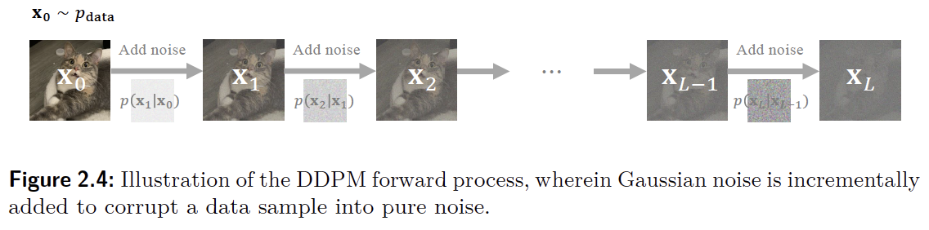
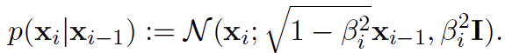
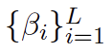
Forward Process (Fixed Encoder)
Each step governed by fixed Gaussian transition kernel:
Sequence fixed (increasing) noise schedule.

Slide 24
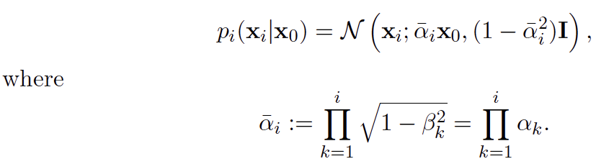
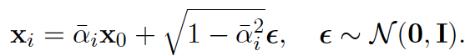
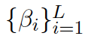
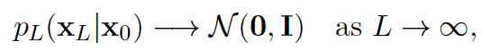
Forward Process (Fixed Encoder)
Linear Gaussian kernels can be marginalized to get closed-form conditional:
So we can directly sample x_{i} from x₀ as:
For increasing marginal converges to standard Gaussian:

Slide 25
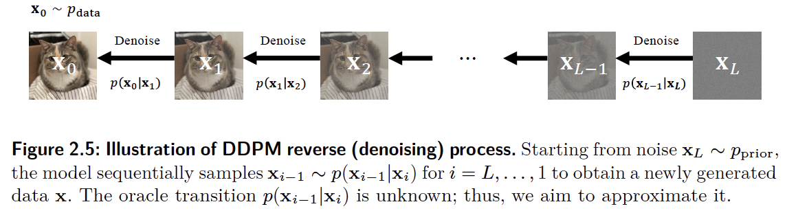
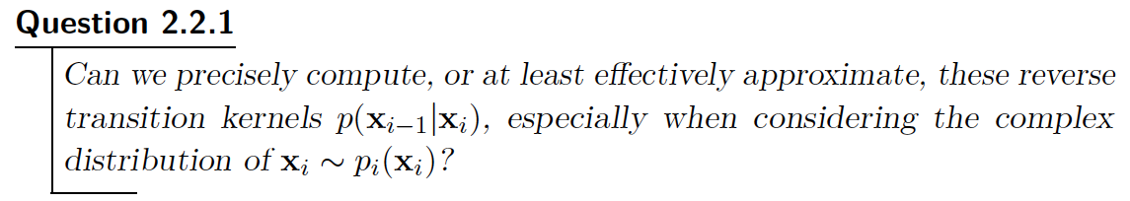
Reverse Denoising Process (Learnable Decoder)

Slide 26
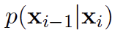
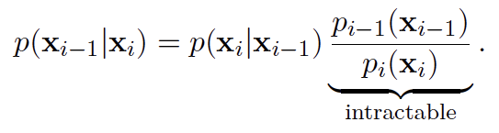
Overview: Modeling and Training Objective
Goal: Approximate the reverse transition kernel by minimizing:
Target
Parameterized model
But, calculating the target is intractable ☹ :

Slide 27
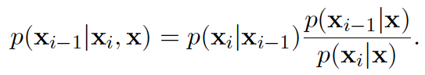
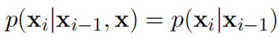
Overcoming Intractability with Conditioning
Condition the reverse transition on “clean” data x:
Gaussian
Closed-form
Tractability arises from two key properties of the forward process:
Markov independence:
All forward kernels are Gaussian

Slide 28
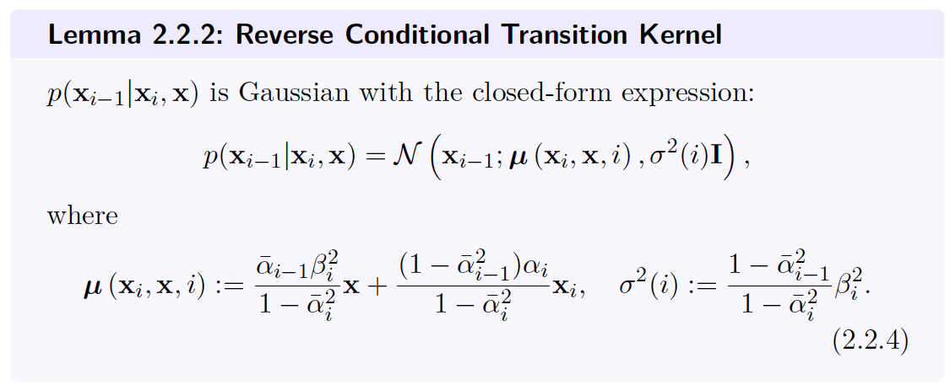

Slide 29
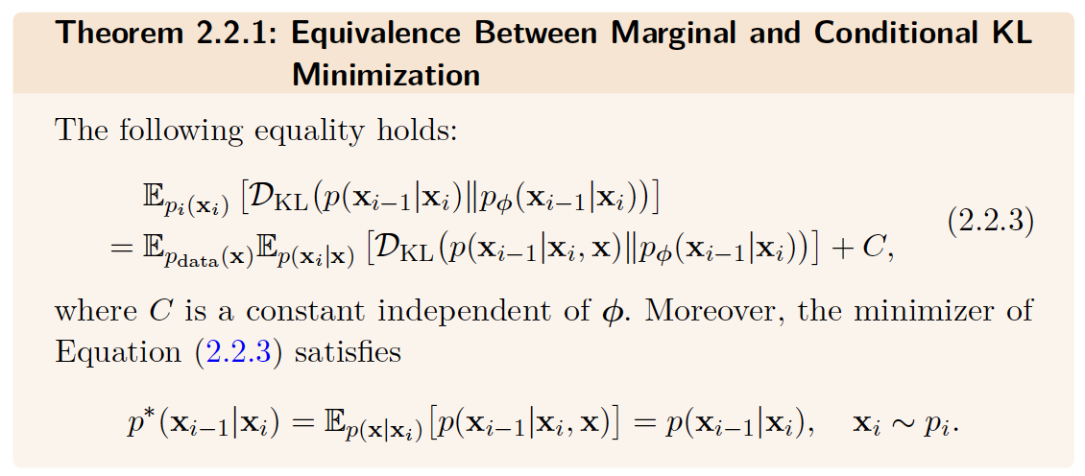

Slide 30
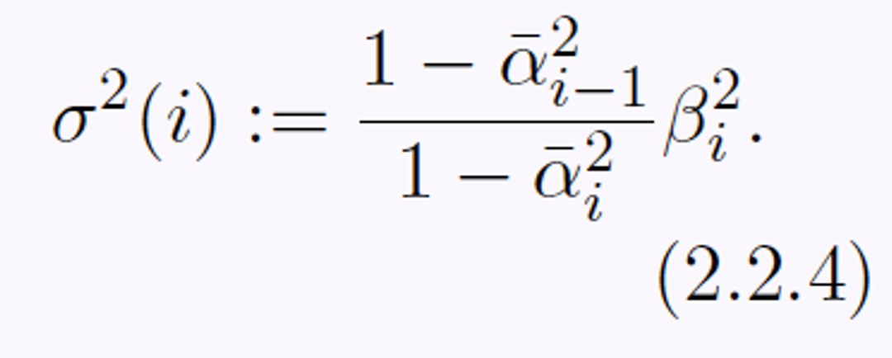
Modeling the Reverse Transition Kernel
DDPM assumes a Gaussian reverse kernel:
Learnable mean function
Fixed variance sequence:

Slide 31
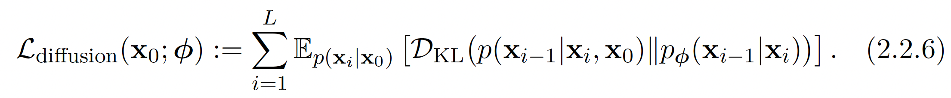
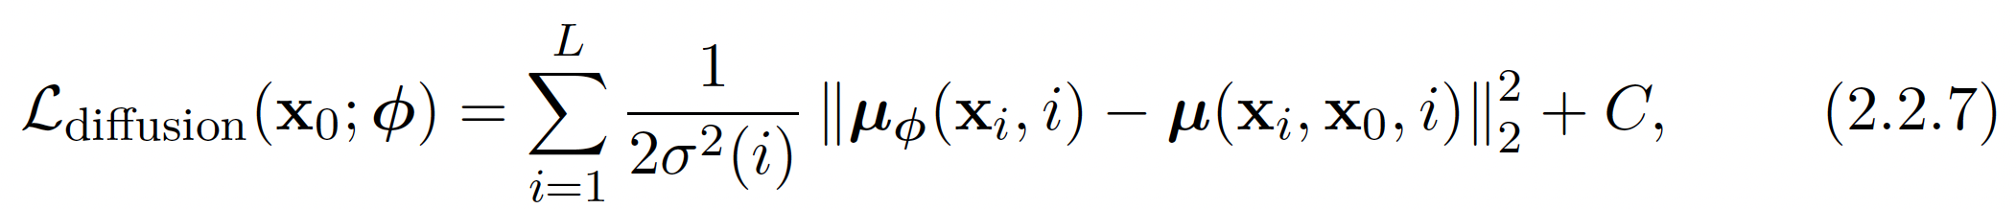
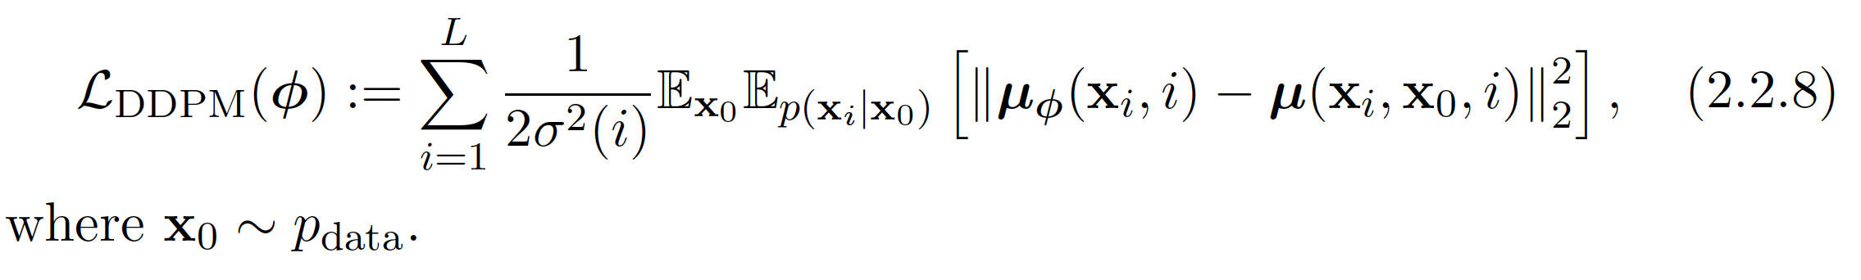
Modeling the Reverse Transition Kernel
Average KL over timesteps i:
Substituting Gaussian distributions we just have MSE:
Average this over data generating distribution:

Slide 32
Practical Choice of Prediction Loss
Recall our prediction loss in terms of MSE of the means…
…practical implementations don’t minimize this. Instead they minimize a reparameterized loss known as 𝜖-prediction.

Slide 33



Practical Choice of Prediction Loss
Recall DDPM forward process generates a noisy sample generated by:
I think this should be x₀
Recall the mean from Eq. (2.2.4):
Can rewrite this (using Eq. (2.2.9)) as:

Slide 34


Practical Choice of Prediction Loss
Motivates parameterization of the model mean:
Now, substitute this into the MSE loss:
Intuitively, model acts as a “noise detective”
Estimates random noise added at each step in forward process
Subtracting noise estimate moves sample closer to clean data

Slide 35
Simplified Loss with 𝜖-Prediction
In practice we omit the weighting term (which depends on i) to get:
Huh?
Target noise has unit variance
Maintains consistent scale across timesteps I
Prevents vanishing / exsploding gradients

Slide 36

Simplified Loss with 𝜖-Prediction
In summary, we have the full DDPM loss:
And the simplified 𝜖–prediction loss:
Both losses have same optimal solution because Eq. (2.2.10) is essentially a least-squares problem:

Slide 37


DDPM’s ELBO
Recall, the reverse transitions are given by:
Gives us a full joint distribution on the generative process:
Which yields the marginal over clean data:
Recall our original training objective (prior to Gaussian assumption):

Slide 38


Slide 39

DDPMs Elbo

Slide 40


Sampling
OK, that’s it for training… 😰
Now let’s move onto sampling…luckily that’s much easier! 😀
Starting from pure noise we recursively sample
Continue until we obtain a clean sample x₀

Slide 41

Algorithm
Sequential=slow
Note: This uses a slightly different, but mathemagically equivalent, reparameterization from the original DDPM paper.

